Slide 1
Social Media Marketing
Dr Avinash Panwar

Slide 2
Social media is the fastest growing trend in the history of the world.
In approx. 10 years, Facebook crossed 2 billion monthly active users (one out of every four humans on this planet has a Facebook account).

Slide 3
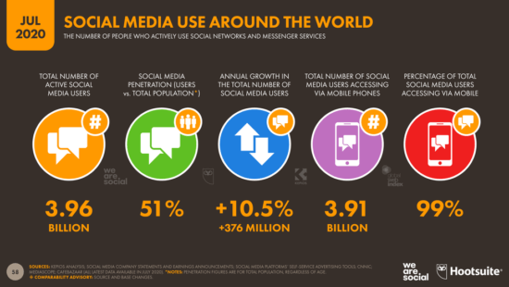

Slide 4
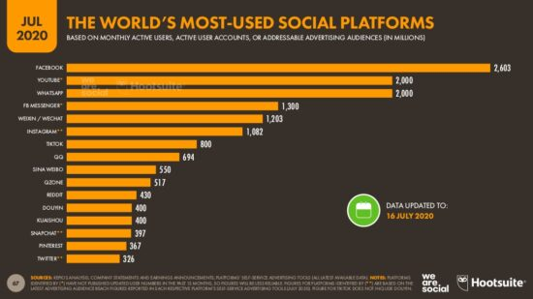

Slide 5
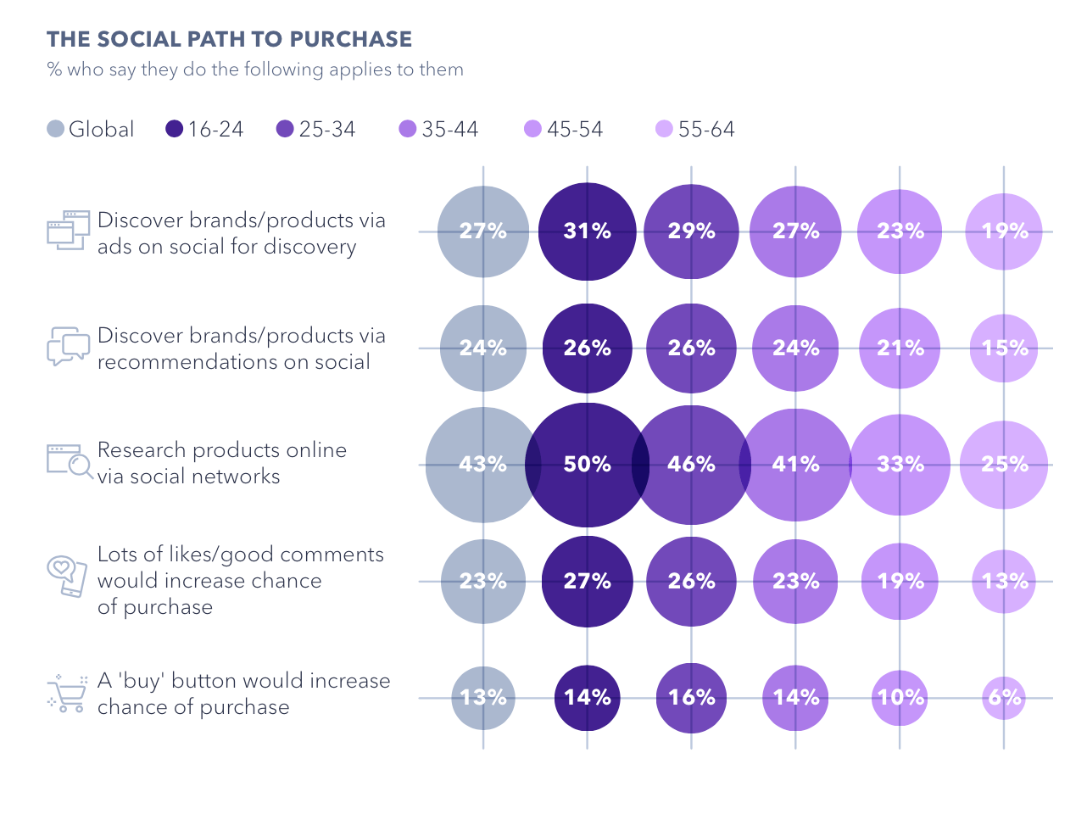

Slide 6
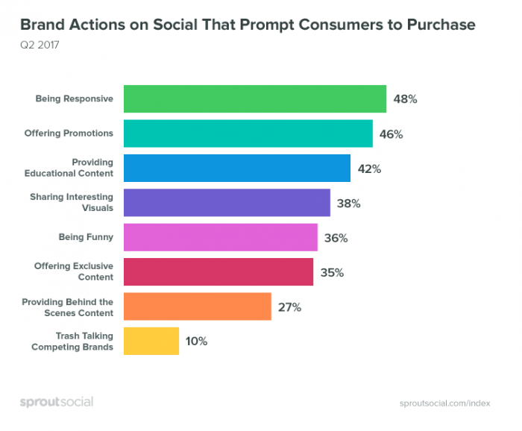

Slide 7
Definitions
Social Media: Internet and mobile-based channels and tools that allow users to interact with each other and share opinions and content.
It involves the building of communities or networks and encouraging participation and engagement.
Content: Whatever is being posted e.g. a Facebook status update, a photo on Instagram, a tweet, something to pin on a board on Pinterest, and so on.
Hashtags: let you describe the topic of your content or mark it as part of current trends.
Engagement: a general term that means that people interact with the content that you produce. It can be a like, a recommend, a comment, or a share.

Slide 8
Social Media Marketing
A form of digital marketing that involves creating and sharing content on social media networks in order to achieve marketing and branding goals.
It includes activities like posting text and image updates, videos, and other content that drives audience engagement, as well as paid social media advertising.
Examples: Facebook, Twitter, Pinterest, Instagram, LinkedIn, YouTube, etc.

Slide 9
Benefits
Increasing website traffic
Building conversions
Raising brand awareness
Creating a brand identity and positive brand association
Improving communication and interaction with key audiences

Slide 10
Social Media Strategy
1. Set up the social media marketing goals
What are you hoping to achieve through social media marketing?
Who is your target audience?
Where would your target audience hang out and how would they use social media?
What message do you want to send to your audience with social media marketing?
2. Different social media marketing sites require different approaches, so develop a unique strategy tailored for each platform.
3. Social Media Content Planning
brainstorm content ideas that will interest your target audience
Identify the right time to publish
Post regularly and offer truly valuable information that your ideal customers will find helpful and interesting.
4. Active social listening and reputation management.
5. A Consistent Brand Image
The business’s core identity, whether it's friendly, fun, or trustworthy, should stay consistent.

Slide 11
Social Media Strategy
6. Social Media for Content Promotion
Use Social media for sharing the best website and blog content with readers to promote your content and build more followers.
7. Sharing Curated Links
Link to outside articles to improve trust and reliability, and get some links in return.
8. Tracking Competitors
Competitors can provide valuable data for keyword research and other social media marketing insights.
9. Use a mix of organic and paid social media marketing
10. Measure Success with Analytics
11. Social Media Optimisation
10. Social Media Crisis Management
Employees should know how to handle an adverse situation on social media

Slide 12
Social Media Metrics in SEO
Social media feeds into the discovery of new content such as news stories, and “discovery” is a search activity.
Helps build links that in turn support into SEO efforts.
Many people also perform searches at social media sites to find social media content.
Social connections may impact the relevance of some search results, either within a social media network or at a ‘mainstream’ search engine.

Slide 13

Facebook Marketing
Launched on February 4, 2004, by Mark Zuckerberg and his friends Eduardo Saverin, Andrew McCollum, Dustin Moskovitz and Chris Hughes.
Initially the service was limited to Harvard students, which later spread to colleges in Boston, the Ivy League, and Stanford University. Later with the support from various other universities and high school students it grew to a large network of participants.
Features:
Profile Creation: Users can create profiles and upload content consisting of photos, images, personal interests, contact information, family events and other details such as employment status, etc.
News Feed: News feed is available on a user's homepage and highlights information including profile changes, upcoming events, and birthdays of the user's friends.
Chat: Chat is an instant messaging service which facilitates users to communicate with other registered users.
Notes: It has a blogging feature which supports use of tags and images. It allows users to import blogs from other blogging service providers like Live Journal and Blogger. (Disabled after Oct 31st 2020)
Market Place: In the year 2016, Market Place service was launched to post free classified advertisements like the CNET’s Craigslist service.
Page: To connect and share with customers by creating a business page
Like button: Allows users to express their appreciation for other users' posts such as status updates, comments, photos, and advertisements.
Ad: To advertise business, brand or organisation
Group: To find and connect people with similar interests
Events: Bringing together people for a public or private event

Slide 14
Benefits of Facebook
Increased exposure to more than 2 billion global users.
Gather more leads from the network users.
Reduced marketing expenses.
Higher probability to reach a targeted audience.
Use other face book insights. ...for specific tasks (built in analytics).
Increased scope for building brand loyalty.
Ensured and enhanced web traffic for self-business.
Boost search engine operations.

Slide 15

Twitter Marketing
Twitter is an American real-time microblogging platform, publicly launched in July 2006.
Its defining feature is the tight limits on the length of each post – known as a ‘tweet’. Initially this stood at 140 characters, though this figure was doubled in most languages to 280 in 2017.
It currently boasts 330 active monthly users, and a market cap for the quarter that ended in Jun. 2020 of $23,547 Mil

Slide 16
Twitter Marketing
Uses and benefits for business:
Communicating: Twitter is a way to keep followers up to date with current information about the business. Importantly, it lets followers communicate with the company too. For example, cinemas use Twitter to converse with patrons, recommend new release movies and retweet interesting tweets from movie buffs and experts. Retweet is a highly powerful tool.
Generating leads: Tweeting about special offers or new products can encourage followers to find out more, potentially leading to sales. For example, tour operators offer special promotions like 'buy one get one free' via Twitter.
Showing brand's personality: Twitter gives a chance to liven up a company’s image. Tweeting about customers, people associated and brand’s personality, gives followers a sense of business as more than just a supplier of goods or services. For example, the Economic Times, Boston Consulting Group, etc., use twitter widely to promote and distribute insights to users.

Slide 17
Twitter Marketing
Researching trends: Searching or following tweets can give an idea of trends and topics that Twitter users are interested in. Twitter operates in real-time, so one can search for conversations that are happening right now. It can show what Twitter users are saying about the brand, competitors and product category.
Seeking feedback: Many global businesses use social media, including Twitter, to invite online feedback, reviews or comments. This information is useful for businesses that want to improve, and also for potential customers doing research for their own purchases.
Providing customer service: For Twitter-savvy customers, receiving queries and doing services via Twitter is very convenient. A large telecommunications company has capitalized on this, providing a 24-hour response service for all sorts of customer queries, with staff using their names and answering in a chatty, personal tone.

Slide 18

Google+ Marketing
Google+, pronounced and sometimes written as Google Plus, is an Internet-based social network that is owned and operated by Google, launched in June 2011.
In October 2018, Google announced that it was shutting down Google+ for consumers, citing low user engagement and a software error, first reported by The Wall Street Journal, that potentially exposed the data of hundreds of thousands of users.
Google first indicated that Google+ would operate until August 2019, allowing users to download and migrate their information. The company subsequently moved the date up to April.
Google+ was designed to offer significant benefits for a wide variety of businesses.
Users can find information that is relevant to them and share it with other users who share the same interests.
Google+ helps build and widen a network of contacts and also enables to bring business and brand closer to prospective customers and followers in a unique way.
Moreover, Google+ enables to distribute media content effectively and efficiently in order to dominate social media.

Slide 19
Google+ Marketing
Main benefits of using Google+ for business as advocated by the company:
i) Take Advantage of YouTube Generation
Reach a wider audience by effectively using Google+ and YouTube in conjunction. For instance, Google+ users can view your YouTube video when you share them to Google+.
ii) Improved Presence and Reach
Help one’s business build and maintain a strong presence by using features such as Google Maps and Local Business Pages.
iii) Your Conversations archived even after the events
Google Drive, being a cloud based file storage and management service, is capable of sharing huge amounts of information with your audience, including PDFs, presentation slide shows, and password-protected documents.
iv) Use Embedded Posts to Extend the Life of Content
Embedded Posts is a great feature that enables users to share Google+ posts on blogs.

Slide 20
Google+ Marketing
v) Take Advantage of Images
Visual content is a very effective way of capturing the attention of your audience. Social networks such as Facebook, Twitter and Instagram require users to format (resize or crop) images to specific dimensions. Google+ does not adjust or crop pictures.
vi) Format Posts
Google+ allows you to add variables such as italics and bold in order to capture the reader’s attention.
vii) Segment your Audience using Google+ Circles
One can use Google+ Circles to segment contacts as you connect with other members.
viii) Track Performance Using In-Depth Analytics
There are many analytics tools which can be integrated with Google+. For ex: Circle Count and Sum All.
a) Sum All: This tool provides a visual presentation of new Google+ followers, published posts and post engagement.
b) Circle Count: This is a valuable tool that enables you to make key connections by providing you with a comprehensive database of influencers.

Slide 21
Benefits in SEO
Google+ content gets indexed immediately and shows up in search results
By sharing blog posts on Google+ in particular helps to get higher ranking for keyword terms
It also helps to drive search traffic to Google+ profile and then back to the company blog and website
The more people you add to circles and the more people who add you to their circles, the more likely you are to show up in search results for your network.

Slide 22

LinkedIn Marketing
LinkedIn is one of the more professional social media marketing sites.
It is an employment and business oriented social media networking service that operates via website and mobile apps.
Founded on December 28, 2002 and launched on May 5, 2003, it is headquartered in California, United States
It's a great tool for posting jobs and general employee networking.
Recommendations feature on LinkedIn makes a business appear more credible and reliable for new customers.
The Questions section of LinkedIn provides a platform to get established as a thought leader and earn trust by answering questions.

Slide 23
LinkedIn marketing
LinkedIn uses and benefits:
i) Identifying the right people as a customer or prospect (finding their profile).
ii) Receiving introductions or referrals to prospects (via the introductions tool or outside LinkedIn via mail).
iii) Researching out to the relationships between colleagues, customers, prospects and other contacts (see the connections in their profiles).
iv) Eliciting information about customers and other prospects, which makes the conversations online and offline easier (reading their personal and company profile).
v) Maintaining relationships with current customers (Personal contacts, Discussions in Groups and answering questions in Answers)

Slide 24
LinkedIn marketing
vi) Visibility for you as a sales person and your organization and personal branding (your profile on LinkedIn)
vii) Well known Word of mouth publicity (getting recommendations and people talking about you).
viii) Finding the right groups and organizations to be a member of, both online and offline
ix) Picking up trends in the marketplace (Discussions in the groups of your customers and in the groups of your peers).
x) Getting notifications when someone changes jobs. (network updates).

Slide 25
LinkedIn Talent Solutions
LinkedIn introduced a service known as LinkedIn Talent solutions for companies and professionals. It consist of the below three tools:
Recruiter
Recruiter helps in finding the right talent quicker using LinkedIn's most powerful search techniques.
It gives unlimited access to the LinkedIn network of 400+ million professionals
Helps in building a pipeline of top talent to fulfil roles more faster, and collaborate easily with teams so duplication of work is avoided.
Recruiters Lite
Uses LinkedIn’s advanced search tools
Provides unlimited visibility of 3rd degree network
Reach out to top talent with InMail.
Referrals
An employee referral tool to surf matches of best quality between employee's first degree connections and all of open jobs.

Slide 26
References
https://www.smartinsights.com/social-media-marketing/social-media-strategy/new-global-social-media-research/
https://business.linkedin.com/talent-solutions#
www.facebook.com
www.linkedin.com
www.plus.google.com
www.twitter.com

